Slide 1
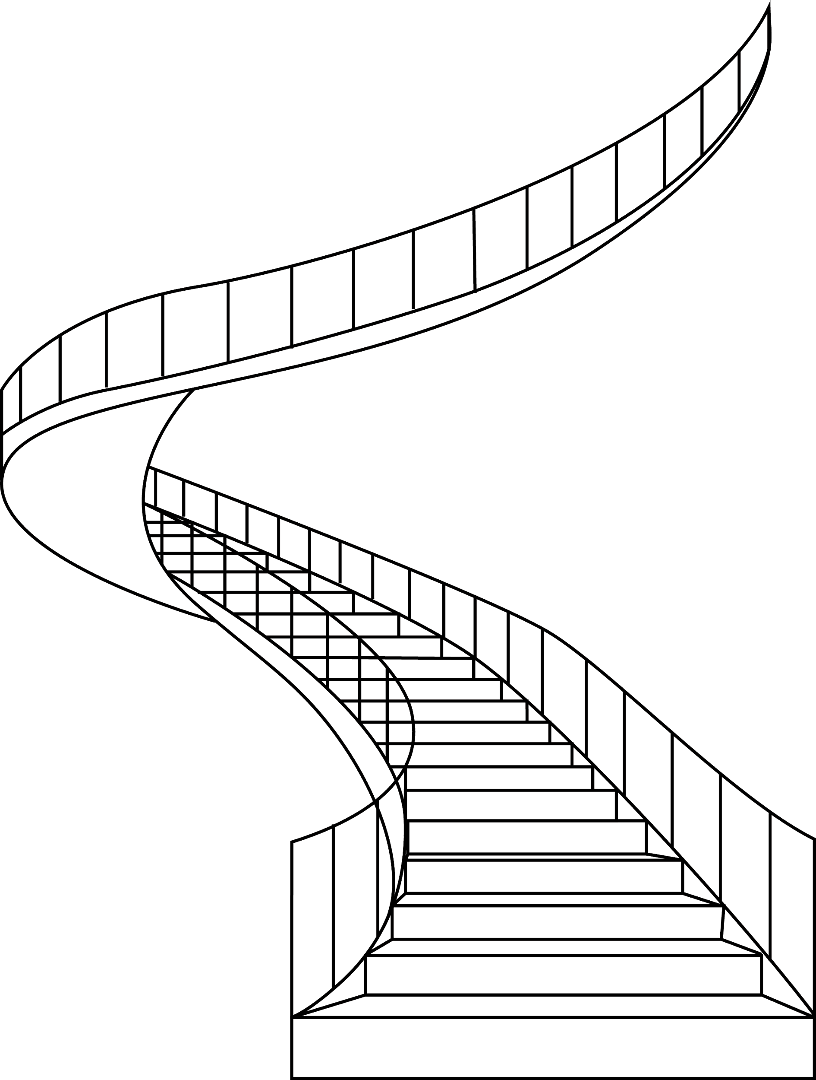
Getting to Senior in UX
Cyd Harrell, UI23
Notes:
Great talking to some of you at lunch. I’m Cyd & one of my core practices as a senior UX person is having conversations with designers who want help. Sometimes project help, sometimes career help, sometimes office-politics help. I hear all kinds of stories and one that I hear often is a story of a really strong designer with maybe 5, 10, 12 years of experience, who’s doing great work at a company that doesn’t have very clear development paths for designers, because it’s not the company’s focus. Sometimes they’re the top designer (or maybe the top designer of their discipline) in their company, sometimes they’re the only designer. This person is usually taking on a lot of responsibility, & to do their job well and grow, they need to figure out how to do more with design, and how to have more influence. DOES THIS RESONATE? It’s a career stage where there’s a bend in the path and it’s hard to see around.

Slide 2
Senior ≠ Management
Notes:
One of the questions people always ask is “do I have to move to management”.There’s often a lot of worry about stopping being a practitioner and moving to management.
-The kind of seniority I’m talking about doesn’t have to mean moving to “management” though it can.
-I have a huge personal appreciation for management practice and how important it is to a team, but that’s not what I’m here to talk about today.
-You can also have management responsibilities like hiring and firing and accountability for budget, without being considered senior in the way I’m talking about.

Slide 3
In a senior role you’re expected to
Lead people (whether they report to you or not)
Shape practice
Represent your discipline internally
Make your organization look good externally (if you’re lucky)
All of these add up to more impact.
Notes:
Because software development, service design...almost everything worth doing - is collaborative these days, there’s no being senior without having a large influence on people. And there’s no getting there without the ability to lead through influence rather than authority.
The biggest things you can influence as a designer is what design tasks your group takes on and how you accomplish them, and how you relate to collaborators outside the design team. There are very few companies where design is assumed - we’re always representing it.
If your company is interested enough in design, they may want to show you off to the world to prove their strength or to recruit.

Slide 4
Seniority comes with
Intellectual & social growth
Recognition & opportunity
Higher pay
Portability to new roles
All of these add up to more freedom.
Notes:
As someone who has made it over the hump into that senior status, I have to say it’s awfully nice. Impt: you can get another job.

Slide 5
Getting there takes more than experience
early career
mid career
senior career
Notes:
It doesn’t happen automatically - while the steps are pretty clear in the beginning of a career there’s no switch at 8 years or 12, or after X amount of time as an individual contributor, or after some particular achievement.

Slide 6
Getting there takes more than experience
early career
mid career
senior career
Notes:
There’s a way through, it’s just that the path takes a little bend. You already know that you’re not alone; let’s talk about how to

Slide 7
How do you become visibly the kind of practitioner people want to promote, hire, and work with for a senior role?
Notes:
Part of the difficulty is that you can have all the capabilities needed for these roles, but in order to get them, the capabilities have to be obvious to others, usually people in power.

Slide 8
Becoming Opinionated
Notes:
Sometimes at earlier stages where you have less power, it can be dangerous to be opinionated.

Slide 9
A senior UXer is their own authority on good practice.
They can confidently share a considered position on how things are best done, in writing or in conversation.
They can cite others they do and don’t align with.*
They are self aware about which of their opinions are most grounded.
*There’s never only one right way, but they take a position.

Slide 10
What is your approach to ____________
experience mapping?
research recruiting?
design systems?
sprints?
accessibility?
personas?
working with engineering?
Notes:
A very common interview question and one where you won’t do well if you don’t have answers. But not just an interview question - someone will hear something about design and ask. Or someone in your group will want clear guidance on something you’re an expert on. The

Slide 11
Strength of opinions across UX elements
Visual Design
Interaction Design
Service Design
User
Research
Content
Strategy
Information Architecture
Industrial
Design
Front End
Notes:
I mapped my own here. (describe)

Slide 12
Strength of opinions across meta-skills
Domain Specific
Mgmt
People Development
Strategy
Team Interaction
Role of Design
Dev Process
Tools

Slide 13
Start getting opinionated with
Which practices have you seen succeed or fail? In what context?
What can you articulate about why?
Notes:
The really important part here, for forming strong, considered opinions, is why. Is it a bad practice? Was it implemented poorly? Was the context not right? How do you think it might work under different conditions.

Slide 14
Critique your heros & your counterparts
What do the practitioners you most admire do wrong?
Think of a partner from a different discipline whose work really complemented yours. What about their way of working made it go so well?
Notes:
Can you critique a design hero? I’ll pick on Jared, since he already knows I disagree.

Slide 15
Becoming A Coach
Notes:
You won’t have to stop being a practitioner, but you will almost inevitably find yourself doing less of the easy tasks where you have the highest, most comfortable competence. Because you’re needed for the harder tasks.

Slide 16
A senior UXer gets great outcomes for their organization by shaping practice.
They spend less time on core design tasks and more time on harder parts around the edges.
They understand how to create the specific design conditions needed to succeed at their specific goals.
They give useful feedback in every interaction.
They have great tips on how to do things, but they focus on why.
Notes:
You’re fluent not just in multiple ways to do something, but in how to make the choice.

Slide 17
The research version
Selecting methods
Setting up recruiting & observing
Conducting sessions
Synthesis
Systems of documentation & communication

Slide 18
The content version
Developing the voice
Content audits
Writing copy
Integration with brand
Systems of governance & communication

Slide 19
The design version
Design system
Project design values
Designing individual elements
Fitting with dev process
Systems of critique & communication

Slide 20
Start coaching with
How can you support people doing the design tasks that are easy for you?
How can you make the hard tasks accessible to more people?

Slide 21
Underpin coaching with
Where do you need to stay hands-on?
Can you come up with guidelines or principles for your team’s practice in certain areas?
Can you articulate a problem-solving approach?

Slide 22
Becoming A Mentor

Slide 23
A senior UXer helps the field by helping others.
They set aside time to share what they’ve learned with people who need it.
They are intentional about how they do it.
In return, they get to sharpen their opinions and communication.
Notes:
I’ve said that, for me, this may be the most meaningful part of my current practice. I’ve been here long enough to think a lot about the kind of design I want to see in the world, and the kind of design field we need to be. This is the way I can help with that.

Slide 24
Mentoring is the ultimate gift of time
Notes:
Making choices.

Slide 25
Start mentoring with
Would you like to see the population of your design field change (at your organization or outside)?
What type of questions can you answer confidently?
How much time is realistic for you to spend?
How will people who need help find you?

Slide 26
Becoming Part of
(a leadership team)
Notes:
While you may be the highest ranked designer or researcher in your organization, no one leads alone.

Slide 27
A senior UXer is a strong teammate to other leaders.
They can bring a design (or sub-discipline) perspective to any team conversation.
They help the entire team align with user needs.
They identify ways for design to support larger goals.
They contextualize business & technical decisions for designers.
Notes:
While you may be the highest ranked designer or researcher in your organization, no one leads alone.

Slide 28
Types of leadership teams
SMT
Product leads w/in a suite
Discipline leads for a project
Group leads in Design
Notes:
IN SHORT: you’ll be co-leading with people from vastly different practice and leadership perspectives
What’s your responsibility to “your” people, and to design?

Slide 29
2-way leadership
SMT
Product leads w/in a suite
Group leads in Design
Discipline leads for a project
Learning & Help
Designers
Notes:
What’s your responsibility to “your” people, and to design?
The up & down, bi-directional nature of leadership in orgs
How to advocate for design from a win-win perspective

Slide 30
Start being a leadership teammate with
How much do you know about what your counterparts need?
How much do you think they understand about your work & your team (if you have one)?

Slide 31
Make the most of teammate-hood with
How clear are the leadership team’s shared goals inside the team? Can you help do better?
How can you make the shared goals clearer to people in design?

Slide 32
Becoming Transparent

Slide 33
A senior UXer opens up their practice so others can understand.
They don’t mystify about their work - anyone who cares to listen can understand why they make the choices they make.
They put as much effort into communicating as they do into practicing.
They create opportunities for people to ask questions and learn, whether they’re part of the design team or not.
Notes:
Communities of practice...

Slide 34
Communities of design practice
People affected by design decisions
Discipline mates
Team
Other people who make design decisions
Other professional designers

Slide 35
Start opening your practice with
How could you invite people in to your team’s workspace?
office hours
newsletter
open Slack channel
workshops
enticing wall work

Slide 36
Start opening your practice with
If an engineer or a senior business leader came by, how would you explain what’s going on? What about an intern?
What is your secret sauce? Can you explain it any better than “secret sauce”?
Are there people in your organization who design without the title? How could you connect with them?

Slide 37
Becoming Public
Notes:
This one is a little bit scary, and I want to proceed with the acknowledgement that being public isn’t always safe for everyone. Our industry strongly favors it though. And there are options that are public in different ways.

Slide 38
A senior UXer is known and respected within a well-developed network.
They may be known internally or worldwide or somewhere inbetween.
That their opinion is sought by others is a signal to non-designers. (Which others is a signal to other designers.*)
They contribute their knowledge back to the field.
*Be very careful about reinforcing assumptions when you send & interpret these signals.

Slide 39
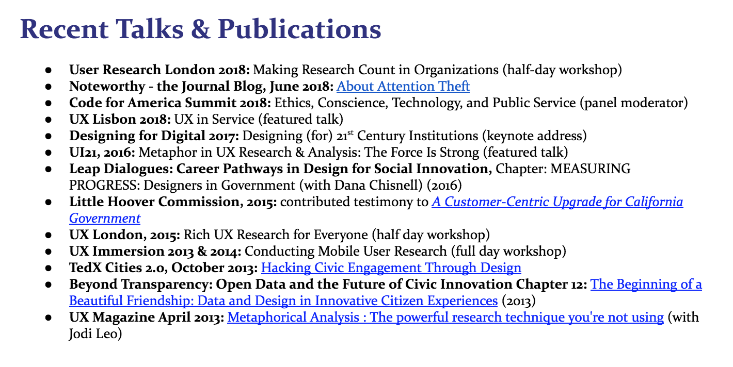
It’s a résumé section (among other things)
Notes:
This signals a lot of things in communicating about my level and interests, and whether “the” (some) community regards me as an expert about some things.
Every speaker on the program has this (check) & it’s a larger or smaller part of their work depending on their specific goals (I speak relatively little compared to the other folks you’re seeing today) “I’m a relatively junior speaker”?
I’ll be honest, I don’t particularly like that this is close to required for serious design seniority (and I know a few people who manage not to do it, so it’s not absolute) but if it’s going to be required, I want to see a greater range of people doing it than we have now
(as I said, that’s one reason I mentor at this level)

Slide 40
You also need your own posse
Professional friends & fans who are not tied to your current job.
Notes:
This is not just for the purpose of possibly leaving your job. This is for perspective checks.

Slide 41
You can be public in many ways
Which ones are right for you (and your employer)?
twitter
medium
company blog
meetup
internal talk
conference talk
podcast

Slide 42
Start putting yourself out there with
What’s the most interesting story from a project you worked on in the last 2 years?
What could your design community learn from that story?
What would you need in order to tell it well as a blog, presentation, or podcast?

Slide 43
Finding The Time
Notes:
So this is all a lot. It’s not intended to be a 2 week process, of course, but it can seem like it’s hard to make time to do this growth work while doing your job. So I’d like to conclude with a few steps you could take in the very near future.

Slide 44
Getting started: minimum viable seniority
Get a notebook (or a text file) & track your opinions as they come up.
Free-write your best UX story. (Edit later.)
Invite one person from outside design to your workspace.
Write up a key underlying practice for your team.
Let someone know you want this.
Notes:
Last line: no one leads alone, no one advances alone. It could be your boss, if they have the power and you have a good relationship.

Slide 45
Follow-on steps:
Get coffee with a UX friend and trade opinions until you’re comfortable saying them.
Pitch your UX story. Or try it out as a Twitter thread.
Set up a regular time or place for open work.
Decide how & who you want to mentor. Make the offer.
Reflect on how you team with leadership peers.

Slide 46
Opinions
Coaching
Mentoring
Leadership Team
Transparency
Going public
Notes:
The path, or one path, through to the greater impact and freedom looks like leveling up this set of capabilities. None of them are technical design, but you’ll need them to do technical design at the next level(?)

Slide 47
You’ll show up as a leader with a well-honed perspective, who shares their knowledge generously and helps others get the most from design.
Notes:
Regardless of your specific skillset, everybody wants to hire this kind of person, everybody wants to work with this kind of person, everybody is glad to listen and dialog with this kind of person. You’ll have a bigger impact, and more freedom.

Slide 48
Questions?

Slide 49
Thank you for coming!
@cydharrell any time you want to talk about this

